Slide 1
Grievance handling information system for Primary Health Care

Slide 2
Outline
Information capture
Information channelling
Alerts
Reporting
Responsibilities towards information system

Slide 3
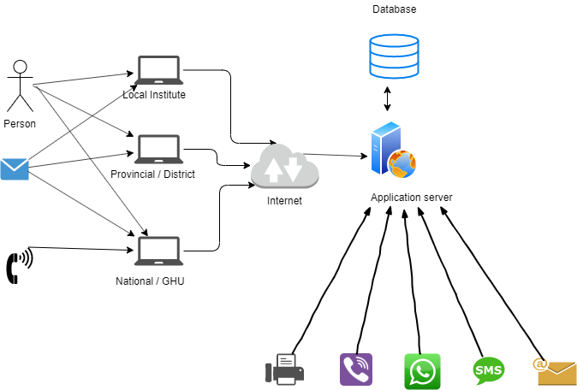
Information Capture
Single national portal
Multiple Channels (Calls/ SMS /Email/Messaging Apps)
Initially functioned 8.30am - 4.15pm (after hour messages recorded and attended next day)
Supported by subnational and institutional level information entry
QR code based boards that clients and can scan and lodge grievance at institution level
Reference issued to client
Non-grievances type communications handled as per SOPs to be developed

Slide 4
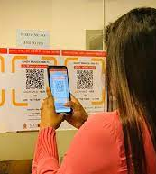
Information Capture
Single national portal
Multiple Channels (Calls/ SMS /Email/Messaging Apps)
Initially functioned 8.30am - 4.15pm (after hour messages recorded and attended next day)
Supported by subnational and institutional level information entry
QR code based boards that clients and can scan and lodge grievance at institution level
Reference issued to client
Non-grievances type communications handled as per SOPs to be developed

Slide 5
Information Channelling
Information diverted to 4 tiers
Information diverted to the lowest possible level for action
Empowering the grassroot level to take action to redress grievances pertaining to themselves
Grievances can be escalated manually if they are not in your purview or needs attention from a higher level authority
Escalate when delays are encountered or client not satisfied with the action taken

Slide 6
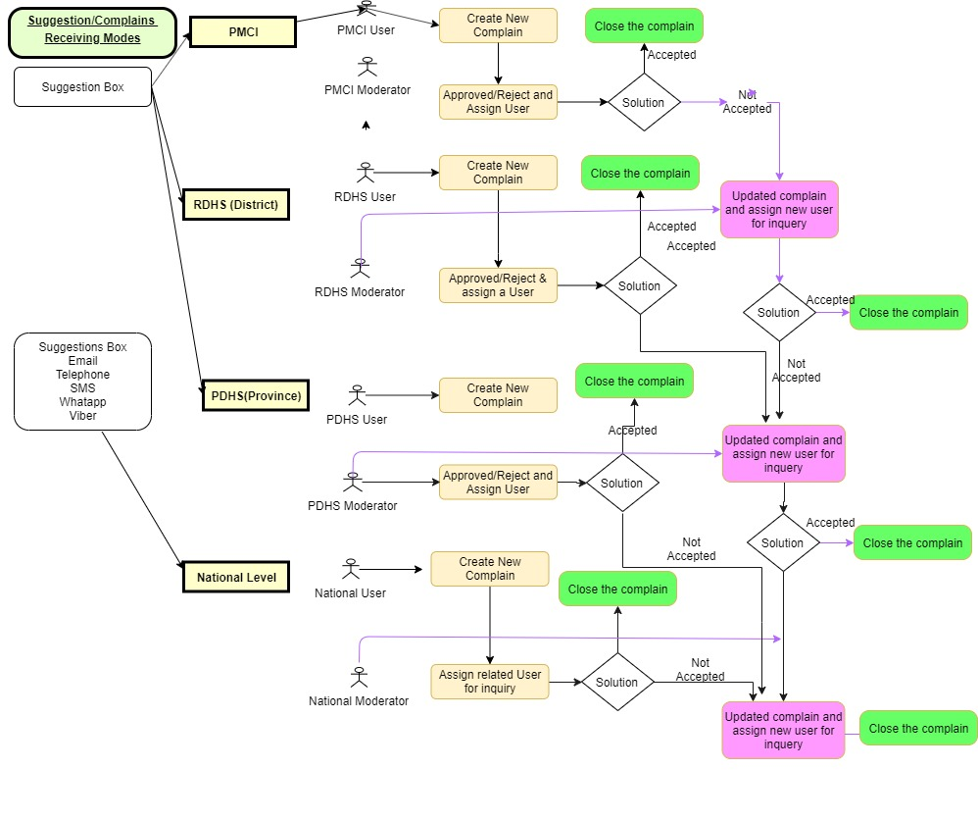
Information channelling

Slide 7
Alerts
SMS and Email alerts generated when new grievances are assigned
Summary emails sent to each level to improve engagement in the process
Reminders when action is pending for grievances prior to escalation to the next level

Slide 8
Reporting
Generate dashboards to help manage grievance handling at each level
Automated periodic reports
Type of grievances received
Trends
Actions taken – ie number resolved, number escalated
Reports generated disseminated via emails

Slide 9
Responsibilities
Update the contact mobile phone numbers and email addresses of focal points of each institution / RDHS / PDHS
Provide IT facilities to access the information system
Use the system to manage the grievances received at the institution level
Establish the grievance handling mechanisms as per developed SOPs and use the information management system as a tool to make the process more efficient and easy to manage

Slide 10
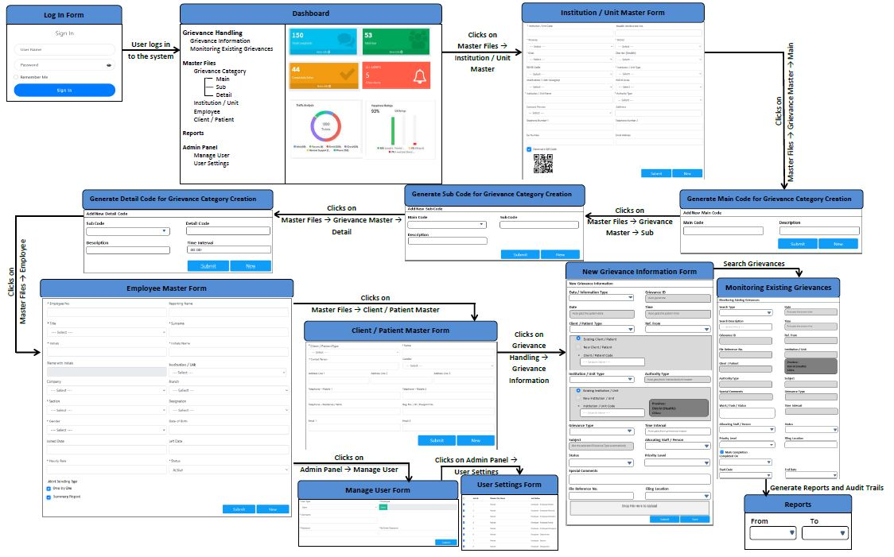
Current progress of the IS
Email and the Short code phone number secured
A virtual call centre setup at the National Level
Focal points identified
Software solution implemented. (Selected places)

Slide 11
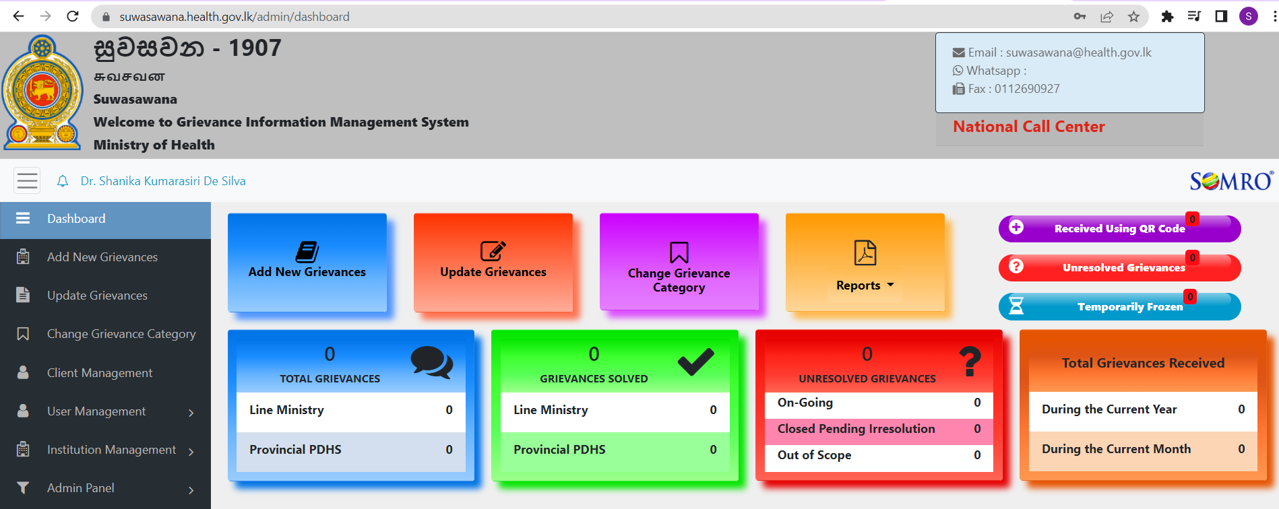

Slide 12
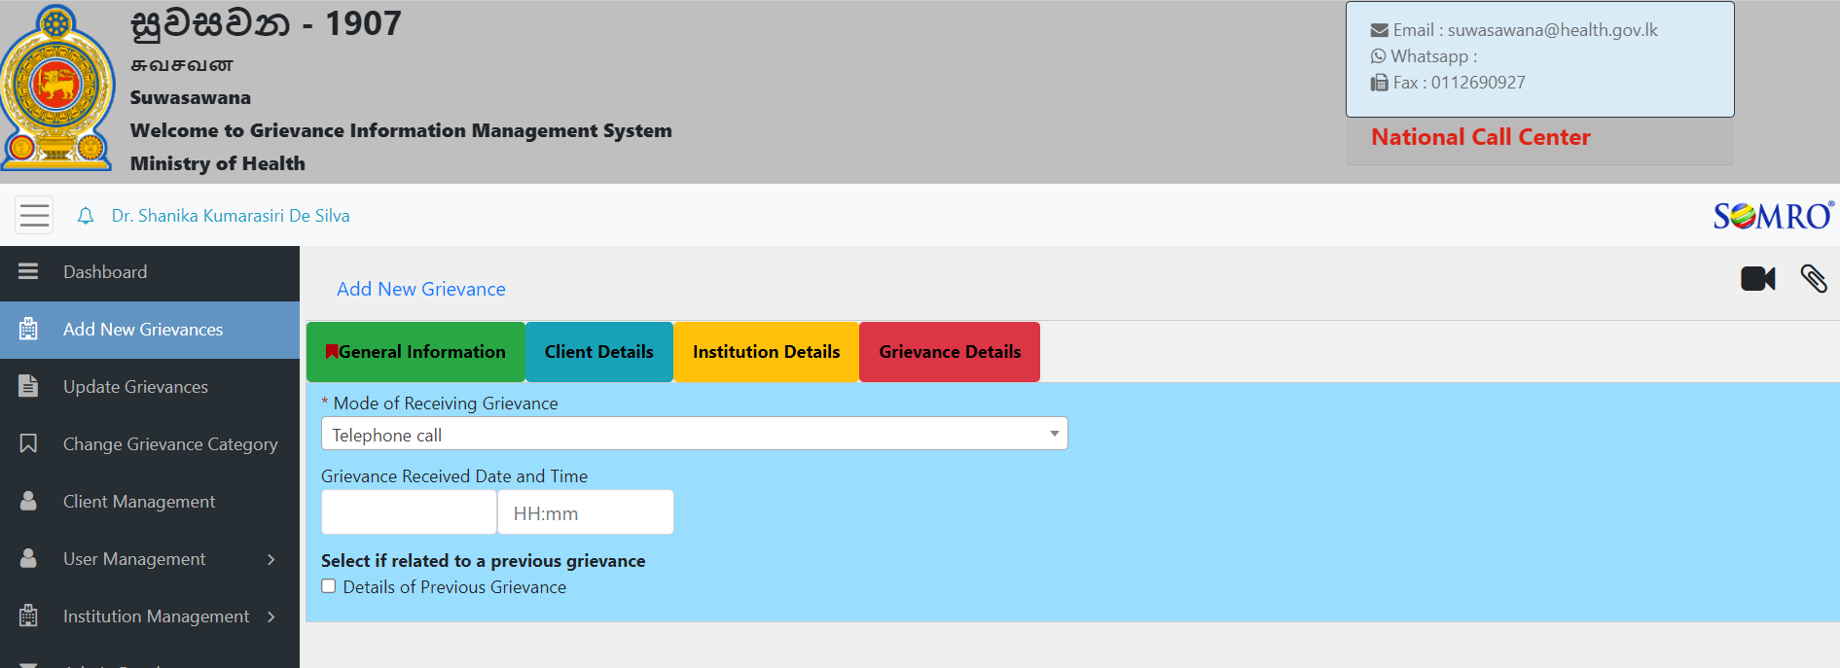

Slide 13
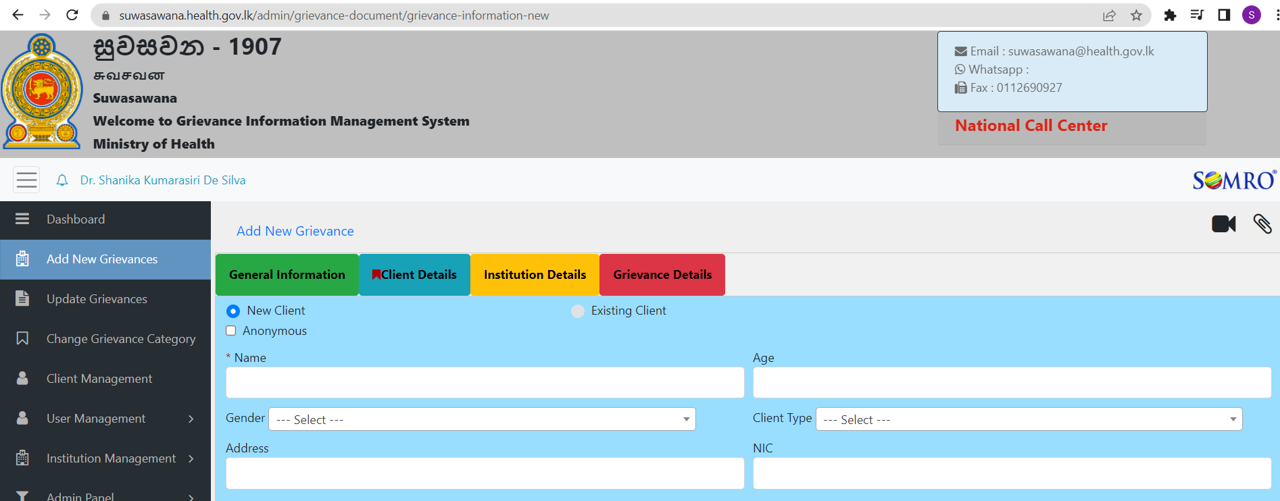

Slide 14


